Slide 2
Impact driven business model and link with Social Entrepreneurship for the INNOVENTER Social Entrepreneurship programme
Ron Beirens, Jef Tavernier
& Ann Vandenbroucke & Lecturers Vives, Kortrijk Belgium

Slide 4
Examples
Notes:
We hope to stimulate your creativity by broadening the scope of social entrepreneurship and through the cases.
Muhammad Yunus: is a Bangladeshi social entrepreneur, banker, economist, and civil society leader who was awarded the Nobel Peace Prize for founding the Grameen Bank and pioneering the concepts of microcredit and microfinance. These loans are given to entrepreneurs too poor to qualify for traditional bank loans.

Slide 5
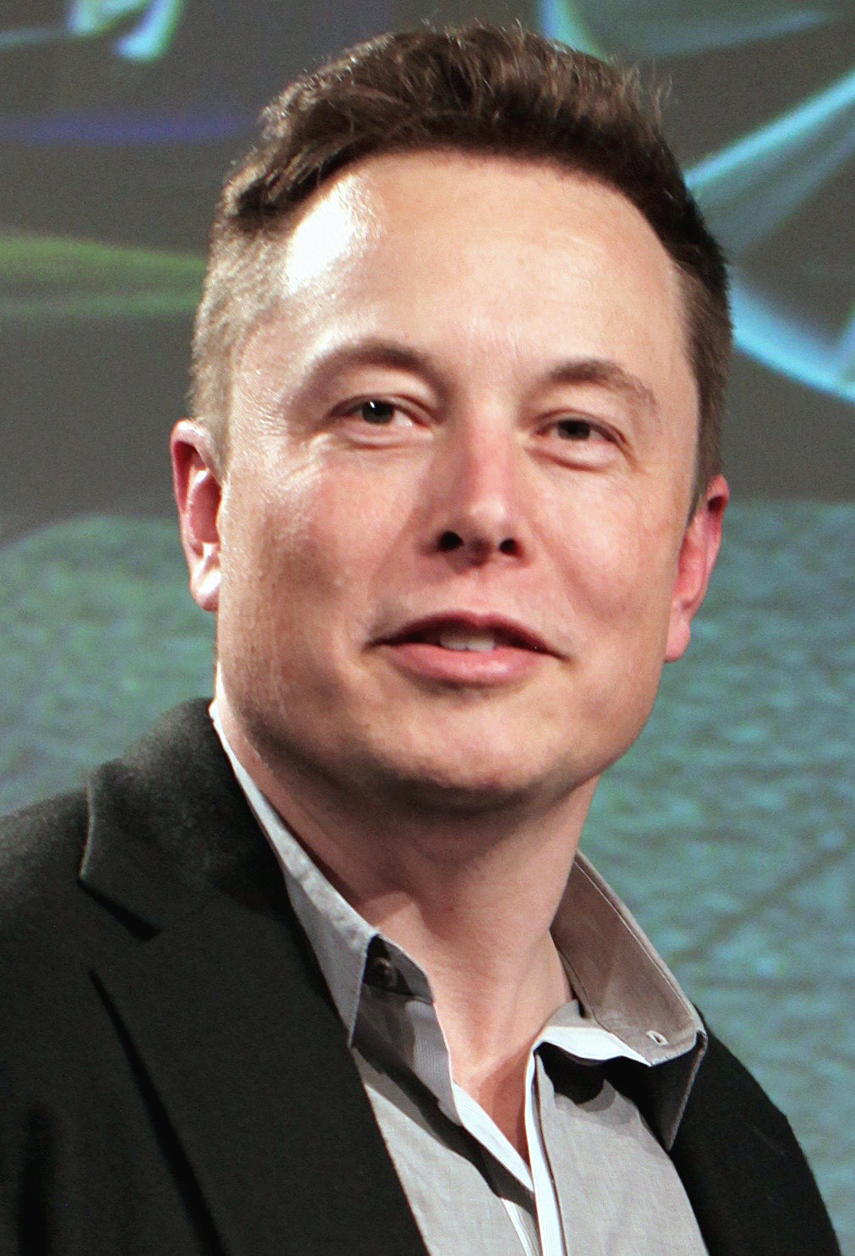
Who’s this man?

Slide 6
Who is an entrepreneur?
Opportunity identifier
Risk taker
Creates marketable products out of nothing
Able to innovate
Proactive
Autonomous
Independent
Dreamer
Notes:
I suppose everyone knows who’s an entrepreneur. Elon musk could fit Pay pal sold to EbayTesla Space X Hyperloop….
Social entrepreneurs also take risk are proactive….there is a difference but a lot in common as well.

Slide 7
Difference between social & business entrepreneurship
Commercial Entrepreneurship: represents the identification, evolution and exploitation of opportunities that result in profit.
Social entrepreneurship: refers to the identification, evolution and exploitation of opportunities that result in social value.
Value is defined as a permanent process of making choices by the entrepreneur.
Interesting youtube for an audience not familiar with social entrepreneurship
https://www.youtube.com/watch?v=1ecKK3S8DOE
Notes:
Social entrepreneurship must result in social value, profit can social value is a must.

Slide 8
Commercial entrepreneur may create change in the society but that is not the primary purpose of starting the venture.
Social entrepreneur may generate profit but for him/her that is not the primary reason for starting the venture.
For the commercial entrepreneur: ‘wealth’ is the same as profit.
For the social entrepreneur however wealth encompasses creation of the social and environmental capital.
https://www.ey.com/gl/en/about-us/entrepreneurship/entrepreneur-of-the-year
Notes:
IT IS A BIT BLACK AND WHITE BECAUSE THER ARE EXCEPTIONS SOMETIMES BUSINESS HAVE A MAJOR IMPACT BECAUSE OF THE MEANS
TIGER POWER
RUBENS MENIN TEIXEIRA DE SOUZA 2018 WORLD ENTREPRENEUR BUILDING PREFAB BUILDINGS FOR THE POOR

Slide 9
What is a social entrepreneur?
Social
Crucial problems of our society:
Health
Education
Human rights
Environment
Equality
Inclusion
…
Seeks social impact, economic profit is not a measure of success
Entrepreneur:
Brings radically new solution with potential to revolutionize a whole area. Qualities:
Vision
Pragmatism
Creativity
Perseverance
…
Social entre- preneur
Notes:
But both are there to fulfill needs!!!!!
Inclusion toegevoegd

Slide 11
Notes:
Drayton is the founder and current chair of Ashoka: Innovators for the Public, a 501(c)(3) organization dedicated to finding and fostering social entrepreneurs worldwide. Drayton also chairs two other 501(c)(3) organizations, namely Youth Venture and Get America Working!
Drayton's philosophy of social entrepreneurs are individuals with innovative solutions to society's most pressing social problems.

Slide 13
Belgian examples with English websites Case 1 WAAK
Provide our customer with tailor-made solutions through the creation of adapted jobs for employees with working disabilities. Starting not from their disabilities but from their abilities.
1800 people are given a job. Turnover 40 million €. (1 BGN LEV= 0.5113 EUR)
70% of the turnover comes from:
Metal and assembly 8 mill. add value 4,3
Growth 30,4 % (N=232)
Electrical wiring 19,5 mill. add value 9,7
Growth 3,6% (N=736)
https://www.waak.be/en/

Slide 14
Belgian examples
The Mobile School Group is a Belgian social enterprise for helping/teaching streetkids.
https://youtu.be/xHQWXWHaUCI
Notes:
StreetWize: filmpje
ROOF FOOD is an urban agricultural project linked to vegetarian catering. Our mission is to bring healthy and ecological food closer to the general public and to bring a strong and sustainable story: By promoting vegetarian meals with organic vegetables, delivered by a bicycle courier, we save a lot of tons of CO2 every year.
We want to give people who fall outside the regular employment circuit a new chance by means of social employment.
ROF FOOD is a cooperative company and would like to baptize its own beans, independent of structural subsidies.
Translated with www.DeepL.com/Translator

Slide 15
Belgian Examples
Notes:
1 toit 2 ages: intergenerational housing: student-senior; family-student
Alveus: Onze coöperatie met sociaal oogmerk Alveus heeft tot doel om de meest ecologische en ethische uitvaarten te organiseren waarbij sociaal engagement en eerlijke prijzen voorop staan.
Ethiquable: fair trade products
Urban farm company: Stadsboerderij van 4.000 m2 op de daken van het nieuwe slachthuis van Anderlecht voor de teelt van lokale groenten. We apply a combination of rigorous scientific detail and a creative business approach to advise private companies, architects, real estate developers and public authorities on their urban farming projects.
Infirmiers de la rue: Patiënten ter plaatse verzorgen, namelijk op straat, gratis. Sociale herintegratie van daklozen.
Peerby: gebruik maken van spullen van mensen uit de buurt
Tejo: therapeutic assistance for people between 10 and 20 years old,with mental problems
Waak: provides customers with tailor-made solutions through the creation of adapted jobs for our employees with working disabilities. 1800 people work over there

Slide 16
International examples
Notes:
Dialogue in the Dark is one of the world's most exciting life-changing experiences where visitors are guided by blind guides in absolute darkness.
Spoiler alert:As climate change proliferates food insecurity around the globe, it is hard to imagine food surplus go to waste in other parts of the world. This is the global problem Ricky’s Spoiler Alert seeks to solve. By serving as a real-time marketplace for food discounts and donations, the tech company is helping farms and organizations to deal with food excesses and wastage.
Cardborigami: help shelter the homeless and those displaced out of their homes by natural disasters. Her company makes and distributes cardboard shelters that are collapsible, portable and inspired by origami towards that vision.
Disease diagnostic group: Disease Diagnostic Group screens patients for the malaria in just 5 seconds with a reusable handheld device that tests for malaria in 5 seconds detecting magnetic nanoparticles created by the mosquito. Especially beneficial in developing countries the device doesn't require refrigeration and each test costs only 5 cents.
The jackfruit company; Our mission is to transform healthy eating, farmers’ livelihoods, and humanity’s eco-footprint – for the better. wants to replace meat with the world's largest tree-borne fruit: the jackfruit. By transforming the underutilized resource into a meat substitute, the company is providing income for Indian farming families and diminishing the carbon footprint associated with meat-consumption.

Slide 17
What is a social enterprise?
EMES definition of social enterprise
3 indicators reflect the economic and entrepreneurial dimensions of social enterprises:
A continuous activity producing goods and/or selling services
A significant level of economic risk
A minimum amount of paid work
3 indicators encapsulate the social dimensions of such enterprises:
An explicit aim to benefit the community
An initiative launched by a group of citizens or civil society organisations
A limited profit distribution (mainly reinvest)
Notes:
EMES is a research network of established university research centers and individual researchers whose goal has been so far to gradually build up an international corpus of theoretical and empirical knowledge, pluralistic in disciplines and methodologies, around our “SE” concepts: social enterprise, social entrepreneurship, social economy, solidarity economy and social innovation.

Slide 18
Social enterprise
3 indicators reflect the participatory governance of such enterprises:
A high degree of autonomy
A decision-making power not based on capital ownership
A participation nature, which involves various parties affected by the activity
Notes:
One should avoid that owners would behave like ordinary shareholders the more shares the more i Have power.

Slide 19
Lessons learned
Networking is key and should be focused on the goal. Streamline the networking.
Finance is key, this skill is not always present.
“Think finance as off the first day.”
A good sales team is key, this is often forgotten. Because we are so preoccupied with the social impact. The sales team is as professional as in the business world.

Slide 20
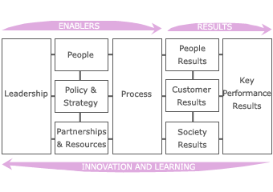
EFQM Model (European Foundation for Quality Management) Leadership leads to Key performance results
Impact on society is important as a result among others.
Notes:
European Foundation for Quality Management

Slide 21
Impact Driven Business model starts from social impact
Notes:
How can we look at a business from a social entrepreneurship angle?
Alternative to Business Model Canvas.
Cogwheels / gear wheels

Slide 22
CASE 2 SOCIAL IMPACT: PASSWERK Acting as a non-social organisation with a social heart
https://passwerk.be/en
https://passwerk.be/en/movie-passwerk-2
Goal: to integrate autistic people into the regular labour market.
Activity: service company that delivers software testing in other companies done by people with an autistic disorder.
Critical points:
Approach: build a successful business from people’s strengths.
Need for a thorough screening and selection of the target group (autistic disorder).
Need to look for the appropriate customer (adaptation of environment).
Forget the“Rain man (Dustin Hofman)” movie.

Slide 23
SOCIAL IMPACT a case: PASSWERK Acting like a non-social organisation with a social heart
Key figures/facts:
Employees n=70 (2017) n=50 (2015)
EBIT (2016) € 525,000 (2015) € 125,000
Decreasing need of financial support from society from €50,000 to €32,000 annually.
Pricing policy is market price, does not come at a discount!
1 BGN LEV= 0.5113 EUR
Notes:
Gaan naar 100!!!2017

Slide 24
1. WHAT DO YOU WANT TO CHANGE? GOALS => WHY?
What’s the mission of the company?
to integrate autistic people into the regular labour market.
Which social challenge is at the basis of (the start-up) of your activities?
To give people with an autistic disorder a meaningful life (also affects family, social security)
Source: Hogeschool Gent, Bracke - Van Wassenhove”.
Notes:
Example:
Passwerk:
streetwize: mission is to improve education for street children

Slide 25
2. WHAT EXACTLY ARE YOU GOING TO DO? BUSINESS CONCEPT => WHAT?
Product/Service:
Which products/services/activities do you offer? Service company that delivers software testing in other companies done by people with an autistic disorder.
Is there a link with social goals? YES
Which customer needs does it satisfy? Reliable software
What is the Unique Selling Proposition of your product/service? Autistic people are very good at detecting errors
How does the organisation distinguish itself from competitors?By the special capabilities of autistic disorder people after a thorough selection
Notes:
Business concept street wize: service: provide coaching sessions to companies to improve teamwork, efficiency through applying the techniques street children use to survive. : clear link with mission, satisfies customers: companies get good training and pay for it knowing that they support a good cause as well. USP: providing training from which not only the companies who come benefit but also the street children.

Slide 26
2. WHAT EXACTLY ARE YOU GOING TO DO? BUSINESS CONCEPT => WHAT?
2. Customers:
Which customer segments do you target? Why? Big organisations, who are capable and willing to invest in creating an appropriate environment. Otherwise it doesn’t work.
Is there a link between the choice of customer segments and the social impact? YES
Notes:
Business concept street wize: service: provide coaching sessions to companies to improve teamwork, efficiency through applying the techniques street children use to survive. : clear link with mission, satisfies customers: companies get good training and pay for it knowing that they support a good cause as well. USP: providing training from which not only the companies who come benefit but also the street children.

Slide 27
3. Revenue model
How does your organisation create revenues? Mainly by invoicing for the work done.
How do the revenues relate to the costs?
The organisation is nearly self-supporting in average over many years. Last year was rather profitable
EBIT (2016) € 525,000 .
How dependent are you from (government) support?
Government support is decreasing. In the future it can do without government support.

Slide 28
3. HOW ARE YOU GOING TO REALISE THIS? RESOURCES=> HOW?
Financing/funding
How much equity is there? There was an initial
government funding of €320,000 the need
was €350,000 according to the business plan.
Which legal form is adopted? Cooperative limited
company not for profit
Composition of personnel: 49 people (2015)
1 director
2 sales persons without autistic disorder
6 Job coaches without autistic disorder
40 programme testers
Assets:
Which are the most important fixed assets
(buildings)?
Which are the most important current assets (liquidity)

Slide 29
4. STAKEHOLDERS AND PARTNERS
Who are the most important stakeholders?
The organisations working for the interest of autistic people and their families, government, large companies, media.
How does the organisation pay attention to contacts with external stakeholders/partners?
Customers: through sales persons
Local community: organisations
Interest groups media
Government: through director and
board
Partnerships
Which ones are the most important ones and why? The organisations for autistic people because growth comes from recruitment.
Which contacts contribute most to the social impact? Same
Notes:
It was in the media and after the programme it went viral…. The number af candidates was overwhelming

Slide 30
5. PROCESSES AND POLICIES
Production policy and processes
How is service/activity achieved? Like a
another testing company but with a thorough preparation and follow-up by the coaches and sales persons.
Sales processes
Which way are products/services offered to the customers? Testing
Which channels of distribution are being used? Personal sales

Slide 31
Logistics policy and processes
which means of transport are needed? Public
transport whenever possible-public spaces are
sometimes stressful.
HR-policy and processes
How is the company organised? Board/director/coaches
Selection: between application and selection there is a fall-out of 60% for people that do not qualify. Feedback when not hired is of crucial importance to candidate and family.
What does the training policy look like? It is very important that coaches do the follow-up to control the working conditions and the well being on the spot.

Slide 32
Marketing policy and processes
What does the marketing management look like? Which actions are being taken? Present yourself as equally efficient as another consultancy company with major strengths.
How is the organisation perceived? Does the reputation match the desired reputation? Is very well received e.g. Customers are established companies Belgian Bank Belfius, Verizon…
Energy policy and processes
Financial policy and processes
Are the benefits reinvested to raise social impact? YES expanding and networking in Germany, Canada and Israel.

Slide 33
Governance
Are there governance and policy mechanisms that benefit the social goals concerning:
Restrictions in distribution of benefits: shareholders can only get the initial investment back (no growth)
Every shareholder has the same voting power whether they investment was 20,000 or 5,000.
Reinvestment of benefits in the company

Slide 34
6. WHAT HAS CHANGED? SOCIAL IMPACT=> RESULT?
Have specific indicators, in economic and social terms, been determined? The less dependency of government subsidies and the good business results are key, as well as price/quality of the service.
Are these defined indicators being accomplished? Yes

Slide 35
IMPACT? Impact Driven Business Model Can it be successful?
Yes it can! Off course not always will it show profit in the income statement of a company.
But it will generate spill-over profits in society who are less visible. In other to conceive one needs to mesure.
“Making the intangible tangible”
The use of the Impact driven business model for commercial reasons:
Any re-use for commercial purposes must be subject to prior approval. Approval must be requested by e-mail to Pol Bracke (Pol.Bracke@hogent.be)

Slide 36
Following slides are at your disposition to fill in
The next slides can be used as empty slides for your social enterprise.

Slide 37
1. WHAT DO YOU WANT TO CHANGE? GOALS => WHY?
What’s the mission of the company?
Which social challenge is at the basis of (the startup) of your activities?
If you already develop activities: do you see opportunities to translate the acquired knowledge /competencies into a new or adapted business concept?
Notes:
Example:
Passwerk:
streetwize: mission is to improve education for street children

Slide 38
2. WHAT EXACTLY ARE YOU GING TO DO? BUSINESS CONCEPT => WHAT?
Product/Service:
Which products/services/activities do you offer?
Is there a link with social goals?
Which customer needs does it satisfy?
What is the Unique Selling Proposition of your product/service?
How does the organisation distinguish itself from competitors?
2. Customers:
Which customer segments do you target? Why?
Is there a link between the choice of customer segments and the social impact?
3. Revenue model
How does your organisation create revenues?
How do the different revenue streams relate to each other?
How do the revenues relate to the costs?
Is there a need/possibility to create new sources of revenues?
How dependent are you from (government) support?
Notes:
Business concept street wize: service: provide coaching sessions to companies to improve teamwork, efficiency through applying the techniques street children use to survive. : clear link with mission, satisfies customers: companies get good training and pay for it knowing that they support a good cause as well. USP: providing training from which not only the companies who come benefit but also the street children.

Slide 39
3. HOW ARE YOU GOING TO REALISE THIS? RESOURCES=> HOW?
Financing/funding
How much equity is there?
How much debts does the organisation have?
Which legal form is adopted?
Composition of personnel: do you have personnel?
Assets:
Which are the most important fixed assets
(buildings, machines, technology, …)?
Which are the most important current assets (stocks, liquidity, …)?
How do the resources contribute to social impact?

Slide 40
4. STAKEHOLDERS AND PARTNERS
Who are the most important stakeholders?
How does the organisation pay attention to contacts with external stakeholders/partners?
Customers
Suppliers
Local community
Interest groups
…
Partnerships
Which ones are the most important ones and why?
Which contacts contribute most to the social impact?

Slide 41
5. PROCESSES AND POLICIES
Production policy and processes
How is a product/service/activity achieved?
Are social and environmental effects taken into account?
Are products and/or packaging recyclable/reusable?
Sales processes
Which way are products/services offered to the customers?
Which channels of distribution are being used?
To what extent are energy and environmental impact taken into account?

Slide 42
Logistics policy and processes
which means of transport are needed?
To what extent are energy and environmental
impact taken into account?
HR-policy and processes
How is the company organised?
Is the organisation control or empowerment oriented?
To what extent does the organisation pay attention to democratic decision making?
What does the training policy look like?
How does the organisational model contribute to the social impact?
Does the organisation pay attention to employment of disadvantaged groups? (internally or through cooperation)

Slide 43
Marketingpolicy and processes
What does the marketing management look like? Which actions are being taken?
How is the organisaition perceived? Does the reputation match the desired reputation?
Energy policy and processes
What does the organisation do to optimize energy-efficiency?
Financial policy and processes
How can the company be more cost-efficient?
Which payment systems are being used?
Are the benefits reinvested to raise social impact?

Slide 44
6. WHAT HAS CHANGED? SOCIAL IMPACT=> RESULT?
Have specific indicators, in economic and social terms, been determined?
Are these defined indicators being accomplished?
Where can/ should there be corrections in processes, means, customer relations, … to increase the social impact?

Slide 45
Sources
Impact gedreven ondernemen, Academia Press, ISBN 978 90 382 2451 0
Video explaining what social enterprises are
https://www.youtube.com/watch?v=1ecKK3S8DOE
Video about streetwise
https://youtu.be/xHQWXWHaUCI
https://www.waak.be/en/
http://www.socialeeconomie.be/knooppunt

Slide 46
Additional Material
For those who know or like to work with the Business Model Canvas. There is an adaptation for the social enterprise. We have an interesting 30 page document in pdf.
Knode_BusModCanv4SocEntDesign_E1LR_(30p).
If you want a guide to measure social impact a professional way the article from Stanford University (33p.) .
SSIR_Webinar-Impact_Compass-Final is very helpful.
It looks at different (6) dimensions of impact you might not have tought about. Available in pdf and word.
Please contact Elka Todorova

Slide 47
MATERIAL
In VIVES Mr. Tavernier has done research on measuring and building social impact and proposes a model that is relating to HRM.
The items are:
JOB CREATION/GIVE JOB OPPORTUNITIES
EMPOWER PEOPLE
INTEGRATE AND INVOLVE PEOPLE
MAKE PEOPLE FEEL GOOD
SOCIALLY FOCUSING ON JOBS FOR THE WEAKEST.
Comparision of organisations on these dimensions text available in word doc SOCIAL IMPACT.

Slide 48
Material from a student
An interesting example comes from an Italian Erasmus student. She managed in a very satisfying way to work with the IBDM model for a fictive enterprise.
This shows the model is very practical and quite easy to apply.

Slide 49
THANK YOU FOR YOUR ATTENTION

Slide 50
QUESTIONS?

